Slide 1

Customer Churn Project Overview
DSC680-T301 Applied Data Science
By: Joshua Greenert
4/27/2023
Notes:
Good afternoon/evening, and welcome to my presentation over the customer churn.

Slide 2

Business Problem
The project aims to address high customer churn rates in banking and telecommunications industries. It plans to develop industry-specific solutions and a machine learning model to predict customer churn accurately. Additionally, the project aims to identify the contributing factors for churn in each industry.
Notes:
Every industry has its own particular difficulties when it comes to client retention. However, today we’ll be covering two popular industries that wrestle with customer churn constantly: the banking industry, and the telecommunications industry. The project aims to use machine learning modeling to accurately predict churn while discerning the contributing factors for churn within each respective industry.

Slide 3
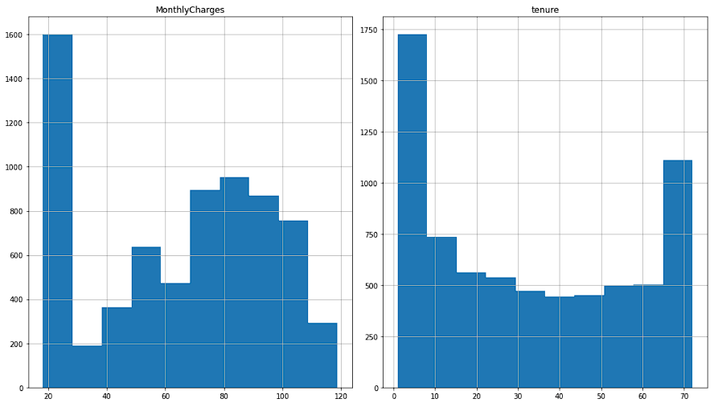
Visualizations (Telecommunications 1)
Notes:
As a good standard, I like to graph my data before diving in. The two histograms seen in this image indicate the relative tenure per customer, and the monthly charges per customer in the telecommunications dataset. Two major points stand out from the visualizations here. The tenure appears to have some consistent users who remain with the business for long periods of time, but there is a skew in the amount of newer customers (i.e. lower tenured individuals). Additionally, users appear to prefer lower monthly charges. Nothing really new there, but it’s visible in the data.

Slide 4
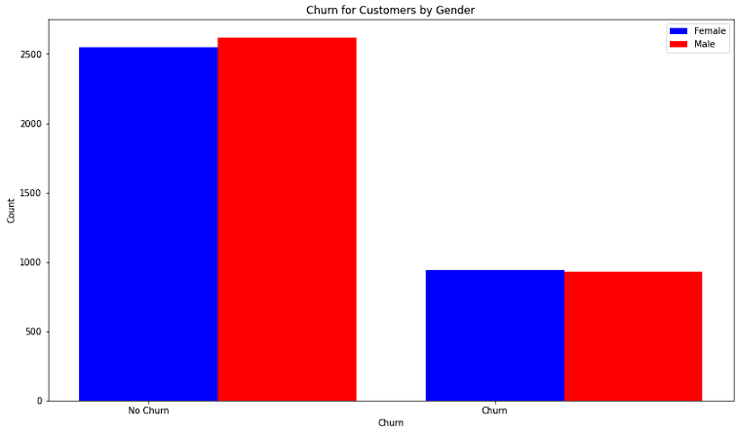
Visualizations (Telecommunications 2)
Notes:
When we look at the telecommunications data by gender, we can see it’s fairly even. Likewise, we can see that the churn rates are similar as well for each group. This is equally good and bad. Since there isn’t much difference, we can expect that the data will be the same for each group and their respective churn expectation. However, this immediately disproves this field as a potential candidate for reference on which column can assist with churn identification.

Slide 5
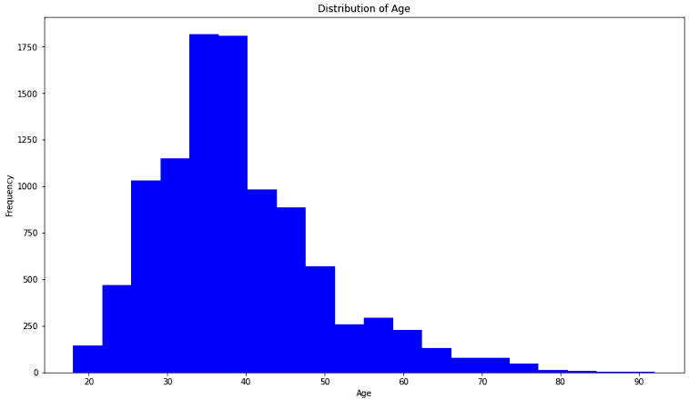
Visualizations (Banking 1)
Notes:
In the banking dataset, we can use another histogram to view the age of customers in their specific age group. With this view, we can tell that our main demographic tends to be between thirty-five and forty years of age. What is surprising here is that the older the client gets, the less likely they are to use our current bank where the data were selected.

Slide 6
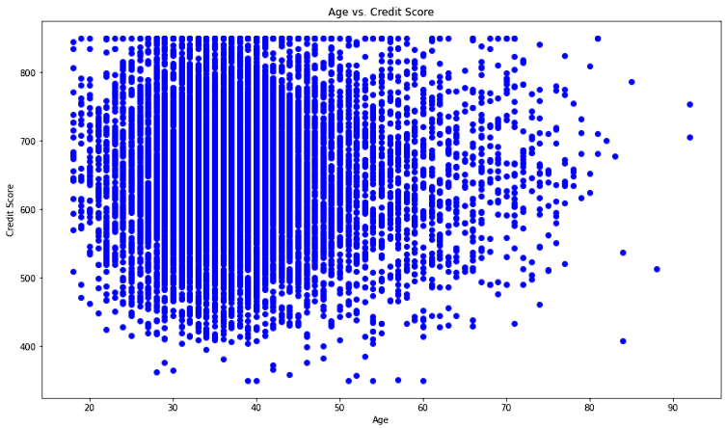
Visualizations (Banking 2)
Notes:
When we compare age to credit score, we see that our previous estimation for average age of user was fairly accurate. We can also see that the majority of our users appear to be within the 550 to 700 credit score range.

Slide 7

Methods
Logistic Regression (LR)
Decision Trees (DT)
Random Forest Regression (RFR)
Notes:
To ensure that all methods were reviewed for the process, a separate model was created for each dataset. The models attempted were the Logistic Regression, Decision Trees, and Random Forest Regression models. The result scores were then check against each model to determine which model worked best, and what values it thought were the most important features by percentage.

Slide 8
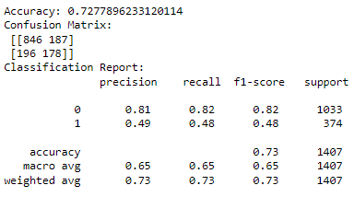
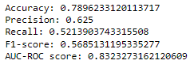
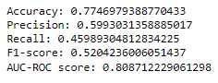
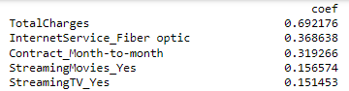
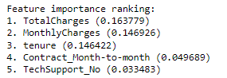
Analysis - Telecommunications
Logistic Regression
Decision Trees
Random Forest Regression
Notes:
For each model, the accuracy scores were created to compare the accuracy of the model’s predictions. Regarding the telecommunications dataset, the logistic regression held the highest accuracy precision, recall, f1-score, and AUC-ROC score. According to the features listed for Logistic regression and random forest regression, we can see that TotalCharges appear to be the feature with the highest predictive power for customer churn. Additionally, both models seem to have Contract_month_to_month in their top five which confirms that the charge amounts should be reviewed as well as the monthly contracts, and whether those charges should be adjusted or alternative modifications to the contracts should be made.

Slide 9
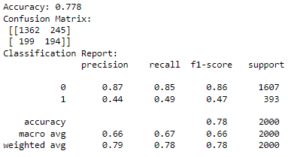
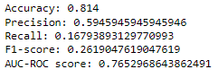
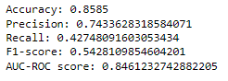
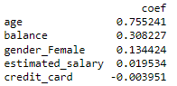
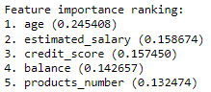
Analysis - Banking
Logistic Regression
Decision Trees
Random Forest Regression
Notes:
Regarding the banking dataset, the random forest regression held the highest accuracy precision, recall, f1-score, and AUC-ROC score. However, the recall score of 42% indicates a high level of false positives. One major possibility is that the use of additional data may assist the model in performing more accurately. Nevertheless, the features determined to hold the most predictive power were age, estimated_salary, credit score, and balance. Age is a column identified by the logistic regression model as well as balance, so those features may require some visibility and additional exploration to discover what might be happening.

Slide 10
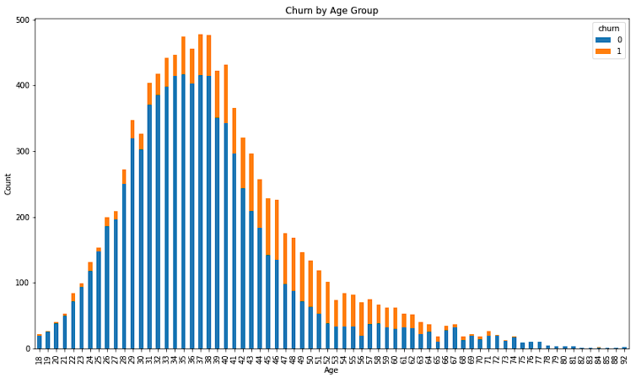
Interpretation of Results
Notes:
As for the telecommunications dataset, we can clearly identify that total charges and timely contracts should be reviewed. Retention strategies can be applied after performing cost benefit analysis to determine the difference of cost for new users, or retention efforts to maintain existing users. The banking dataset, however, is not as easily diagnosed. Even when reviewing churn by age, the data appear inconclusive. While it would be wise to provide retention strategies for the main demographic suggested by the churn, there may be additional factors that lead to its occurrence. One major point to consider for any banking industry is to review their customer service practices as customer service tends to be a major factor in customer retention and brand loyalty (Mailchimp, 2022). Customers that are predicted by the model to be potentially churning can be contacted for upselling and service advisement.

Slide 11

Ethical Assessment
Customer Data Used
Notes:
The only ethical concern regarding either dataset is the use of customer data without the explicit consent of the customer. To mitigate this ethical consideration, the project will ensure that all data used is publicly available and anonymized. Any findings or models will be shared in a transparent and accessible manner, with clear explanations of the methods used.

Slide 12
Questions Asked By Audience
What are the most effective retention strategies for different customer segments?
How do changes in the industry or regulatory environment affect customer churn?
What is the potential impact of churn on a company's financial performance?
How can companies use data analytics to identify customers who are most likely to churn?
What are the ethical considerations when implementing retention strategies?
How can companies balance the costs of retaining customers with the costs of acquiring new ones?
What are the limitations of using historical data to predict future churn?
How can companies measure the effectiveness of their retention strategies?
What role do customer preferences and attitudes play in churn?
How can companies ensure that their retention strategies are in compliance with relevant laws and regulations?
Notes:
What are the most effective retention strategies for different customer segments?
The most effective strategies vary, but some common ones include personalized marketing, loyalty programs, and — of course — excellent customer service.
How do changes in the industry or regulatory environment affect customer churn?
Changes in the industry or regulatory environment can impact customer satisfaction or change the competitive environment. For instance, new regulations could lead to price increases which will have an impact on customer churn.
What is the potential impact of churn on a company's financial performance?
Churn has the potential to reduce revenue, increase new acquisition costs, and lower the tenure of the average customer.
How can companies use data analytics to identify customers who are most likely to churn?
Data analytics can be used to view historical information and to review behaviors and demographic information. With this data, machine learning models can be used to identify major churn factors within the data.
What are the ethical considerations when implementing retention strategies?
The main ethical considerations when using retention strategies would include transparency, respecting customer privacy, and avoiding potentially manipulative strategies.
How can companies balance the costs of retaining customers with the costs of acquiring new ones?
Companies can view their data and analyze customer lifetime value, then compare that value to the cost of acquiring a new customer. If the cost of acquiring a new customer is more expensive, as it usually is, then a company should identify retention strategies for their respective business.
What are the limitations of using historical data to predict future churn?
There are several limitations to historical data. Mainly, the difficulty of capturing all relevant variables and changes in the behavior or environment play a significant role.
How can companies measure the effectiveness of their retention strategies?
Companies can manage this information by using metrics such as retention rates, customer satisfaction scores, or customer lifetime value.
What role do customer preferences and attitudes play in churn?
Customer preferences play a large role in churn as customers may leave due to factors such as poor service, unmet expectations, or lack of engagement. Sometimes, customers aren’t even aware of the value the company provides. This is why there are times where companies may review adding engagement plans within their retention strategies.
How can companies ensure that their retention strategies follow relevant laws and regulations?
Companies must consult legal experts and implement transparent, ethical policies.

Slide 13
References
BlastChar. (2019). Telco Customer Churn. Kaggle. https://www.kaggle.com/blastchar/telco-customer-churn
FlixPatrol. (2020). Streaming services subscribers., from https://flixpatrol.com/streaming-services/subscribers/
Mailchimp. (2022). The Importance of Customer Service: Benefits and Examples., from https://mailchimp.com/resources/importance-of-customer-service/#:~:text=With%20top%20notch%20customer%20service,free%20advertising%20for%20any%20business.
Reichheld, F. F. (2014). The Value of Keeping the Right Customers. Harvard Business Review. Retrieved, from https://hbr.org/2014/10/the-value-of-keeping-the-right-customers
Topre, G. (2021). Bank Customer Churn Dataset. Kaggle. https://www.kaggle.com/gauravtopre/bank-customer-churn-dataset
Notes:
Thank you for coming! Here are the references for your own personal reviewing considerations.

